Slide 1
The Data Cards Playbook
A toolkit for purposeful and people-centric dataset documentation for transparency in AI systems.
https://pair-code.github.io/datacardsplaybook/ #datacardsplaybook

Slide 2


Introduction
01 Ask 02 Inspect
03 Answer
04 Audit

Slide 3
Scopes Brainstorm
THE DATA CARDS PLAYBOOK
Convert your lenses into scopes – questions that will become the building blocks of your Data Card(s).

Slide 4
Break down each lens into sets of telescopic-periscopic-microscopic questions.
Questions that that will be prompts for producers to provide information that is most useful for agents.
Moderate

Slide 5


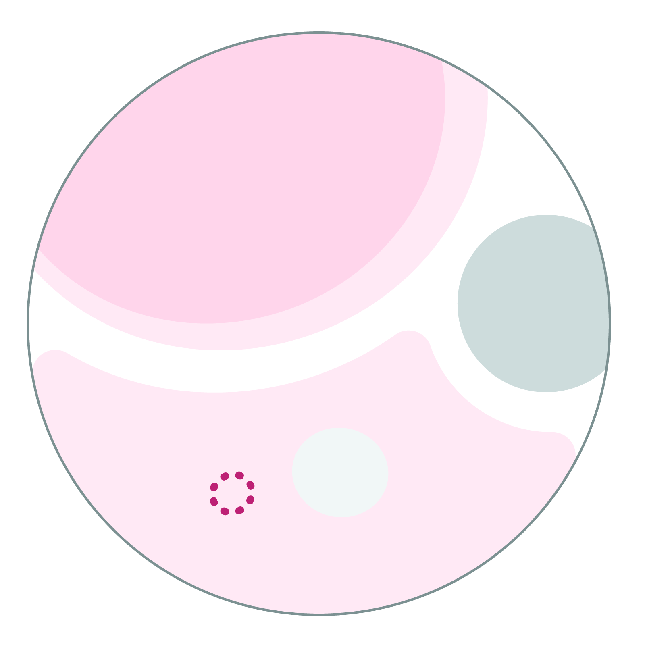
Types of scopes
Telescopic
Questions about attributes or characteristics commonly found across multiple datasets.
For example: Does this dataset contain S/PII?
Data Cards with just telescopes will describe obvious and not add any distinct value, but telescopes tell agents where to begin looking.
Periscopic
Questions about attributes or observations specific to the dataset being documented.
For example: Which features in the dataset contain S/PII?
Data Cards with just periscopes can get overly technical, without any details on context, relevance, or importance.
Microscopic
Questions about unobservable aspects of dataset(s), such as decisions, processes, impact.
For example: How was S/PII handled in this dataset?
If we only use microscopes, we can easily get lost in the details, and lose sight of the bigger picture.

Slide 6
Facilitator’s note
This slide is a handy comparison of the different types of scopes. You can choose to include in your presentation as a reference for participants.
Delete this note once you’re done with it.
 | TELESCOPIC | PERISCOPIC | MICROSCOPIC
Description | Characteristics | Observations | Explanations
Input Type | Yes/No or multiple choice responses | Key-Value pairs or short descriptions | Detailed, long-form descriptions
Format | Tags, Chips | Text, Tables, and Visualizations w/ Links | Paragraphs, Tables, Visualizations, Links
Content | Universal attributes of datasets | Unique, observable characteristics of the dataset | Rationales, decisions, and policies that shape datasets
Utility | Find information quickly; Indexical – search or scan Keywords, descriptors | Facilitate quick assessments Tactical – what statements | Provide context and links to additional information Rationale and process – why and how statements
Value | Provide an overview and help habituate agents in the Data Card. Make Data Cards easy to index in repositories | Often reproducible from the dataset, prevent re-work, and add more context for agents when stacked | Unobservable attributes and considerations important to agents, but accessible only to producers

Slide 7
As a data scientist, I want to know about the structure of the dataset, so I ask…
… what is the data format? … are there any media in the dataset?
… how many features are in the dataset? … how many features are engineered?
… which features are strongly correlated and why? Was this intentional?
EXAMPLE
Facilitator’s note
Here’s an example of a completed AIJ, with clearly established scopes. You can choose to include in your presentation as a reference for participants.
Delete this note once you’re done with it.
telescopic
periscopic
microscopic

Slide 8
[Your name] Brainstorm scopes for the agreed lenses
5
min
Facilitator’s note
Duplicate this for each workshop participant and lens. Refer to the speaker notes for details on how to fill this sheet. We recommend involve individuals who are representative of these agents when filling this out.
Delete this note once you’re done with it.
✍️ As a(n) [perspective], I want to know [lens]
Telescopic Question: ✍️
Expected Answers:
Periscopic Question: ✍️
Expected Answers:
Microscopic Question: ✍️
Expected Answers:
Telescopic Question: ✍️
Expected Answers:
Periscopic Question: ✍️
Expected Answers:
Microscopic Question: ✍️
Expected Answers:
Telescopic Question: ✍️
Expected Answers:
Periscopic Question: ✍️
Expected Answers:
Microscopic Question: ✍️
Expected Answers:
Notes:
Recommended duration: 5 minutes per lens. Cycle through all lenses
Pro-tip: Focusing on “Sets” of lenses will uncover important ways of framing answers.

Slide 9
15
min
Facilitator’s note
Duplicate for each lens. These scopes will become the building blocks of your Data Card.
Delete this note once you’re done with it.
✍️ Lens
Cluster your scopes
✍️ CLUSTER NAME
✍️ CLUSTER NAME
✍️ CLUSTER NAME
✍️ CLUSTER NAME
✍️ CLUSTER NAME
Notes:
Recommended duration: 15 minutes
Pro-tip: Cluster-as-you-share. Once everyone has had an opportunity to add their lenses, discuss each cluster and look for ways to consolidate the cluster. You likely wrote scopes that are similar, so create groupings of similar scopes and decide which of the similar scopes have the best phrasing.
How: Volunteer a participant to share their lenses and place them on this slide to get the conversation going. Use this as a starting point for other participants to share their lenses and add them to the slide to create clusters.
How many scopes should a Lens have?
Scopes occur in sets of telescopic-periscopic-and microscopic. It could be one set to many. It’s more important to think of what is important for the agent, especially as it relates to the dataset(s). However, you do want to make sure it is manageable, which means it best to have no more than three sets of scopes per Lens.

Slide 10
Checklist
YOU SHOULD NOW HAVE
_
Sets of questions that probe different facets of the dataset
A shared intuition around how questions are related to each other
Well-organized scopes that are building blocks for your Data Card
Expectations around what constitutes a response to the question
✔
✔
✔
✔

Slide 11

#datacardsplaybook
The Data Cards Playbook ↗ is an adaptable toolkit of participatory activities, conceptual frameworks, and guidance that support Responsible AI practices for transparency in dataset documentation.
If you’ve adapted, implemented, or have feedback for this guidance, we’d love to hear from you at https://github.com/pair-code/datacardsplaybook ↗.
Find the complete playbook at https://pair-code.github.io/datacardsplaybook ↗

Slide 12

The Data Cards Playbook ↗ by the People + AI Research Initiative ↗ at Google Research ↗ is licensed under a Creative Commons Attribution-ShareAlike 4.0 International License. You are free to share and adapt this work under the appropriate license terms ↗.

